Slide 1
How to do Berreman 4x4 simulation
Gen Kamita

Slide 2
Will: tell you how to do the simulation on mac and windows
Will not: explain the theory

Slide 3
Installation of python
Mac: you already have python
Windows: Search google “anaconda python”

Slide 4
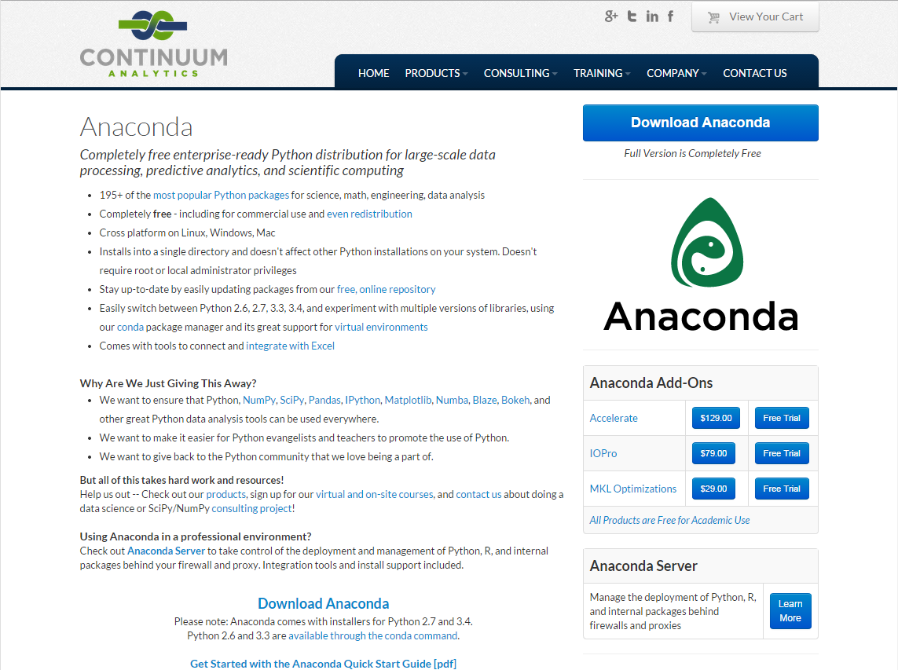

Slide 5
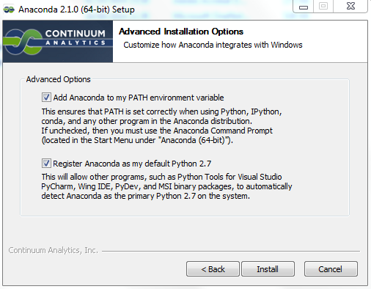

Slide 6
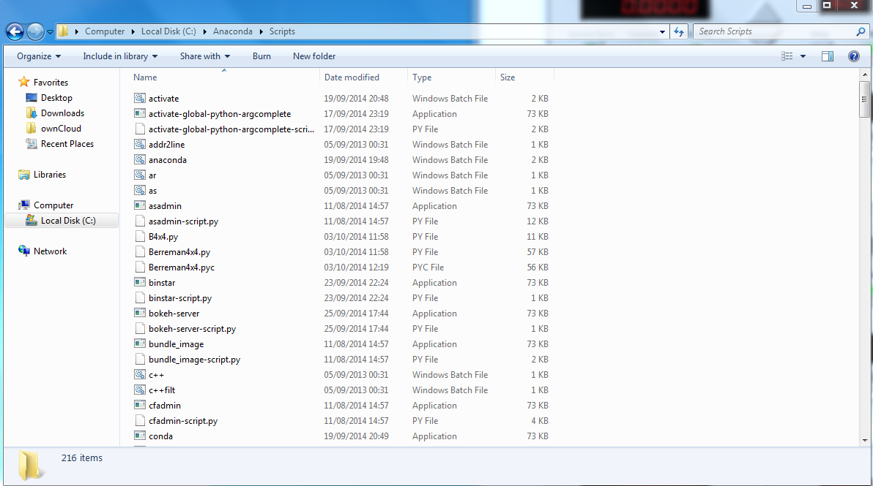
Copy files from own cloud
to here

Slide 7
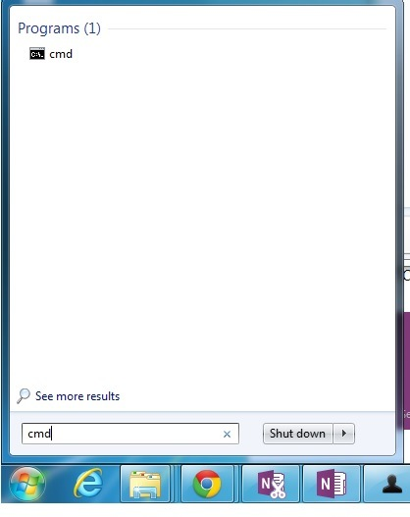
open command prompt

Slide 8
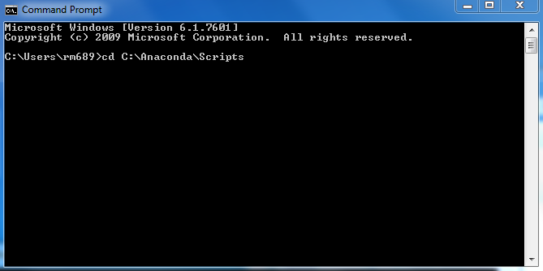
change directory

Slide 9
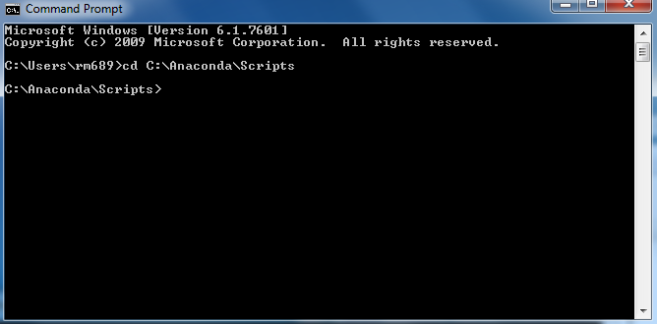
directory changed

Slide 10
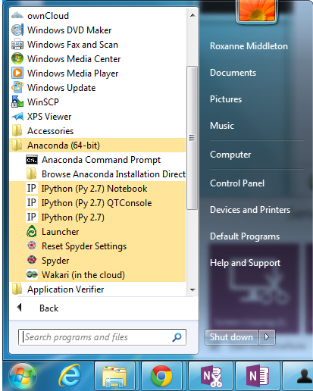
ipython

